Slide 1

Solar Energy Prediction using Gradient Boosted Regression Trees
CC5240
Data Modelling in Atmospheric Sciences
Presented By
Satyajeet Singh (GS23MTECH11107)
Shovan Jana (GS23MTECH11108)
Guided By
Dr. Shruti Upadhyaya

Slide 2
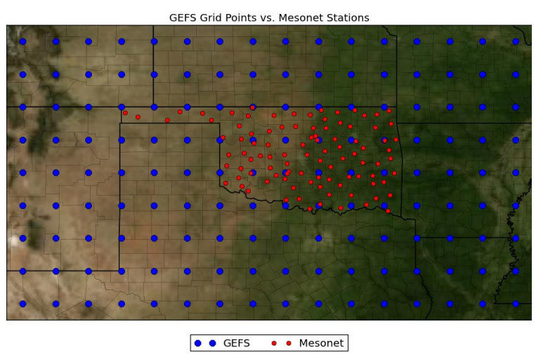
Introduction
Solar Energy fluctuates with changing weather conditions.
Accurate forecasts of energy production is required for Electric utility companies to avoid large expenses. Machine learning technique is used to produce accurate forecasts.
AMS 2013-2014 Solar Energy Prediction Contest- Forecast daily solar energy with an ensemble of weather models.
Input numerical weather prediction data for the contest comes from the NOAA/ESRL Global Ensemble Forecast System (GEFS) Reforecast Version 2.
Data include all 11 ensemble members and the forecast timesteps 12, 15, 18, 21, and 24.
We are trying to work with a particular Mesonet site- “WEAT” (35 lat 262 long).

Slide 3
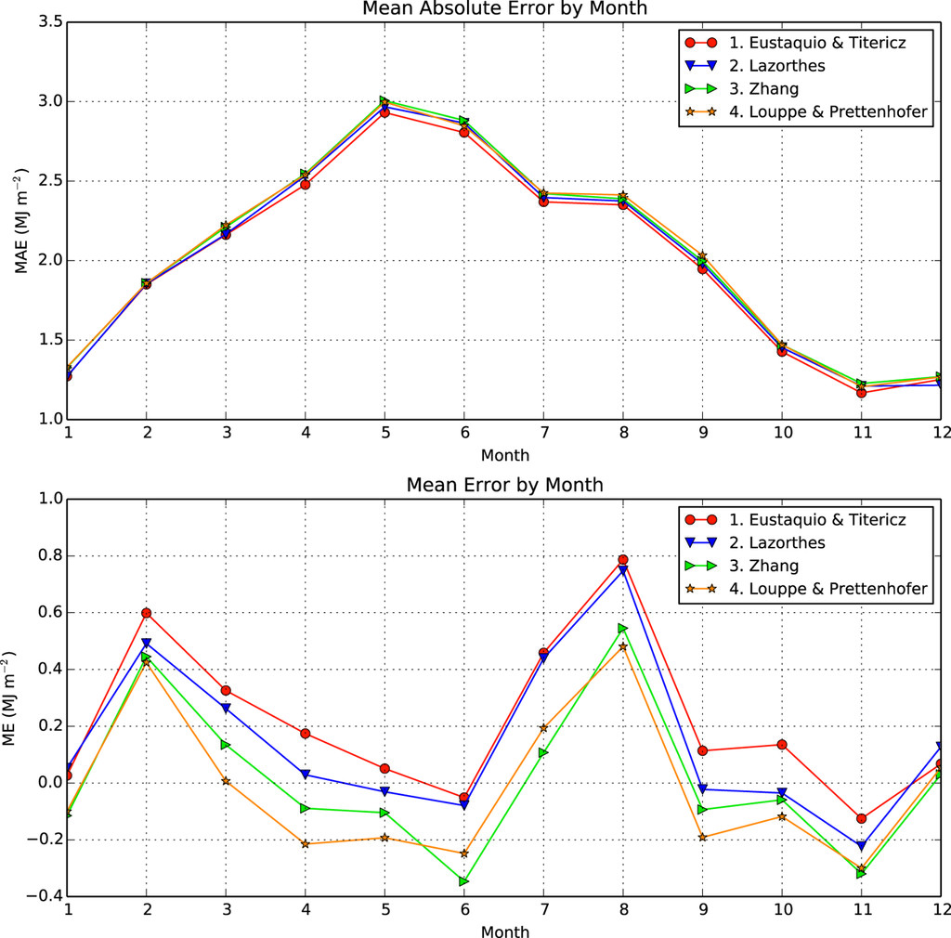
Results from the reference paper
Evaluation metric - Mean absolute error (MAE) over all stations and days.
All the winning methods- same regression technique, Gradient Boosted Regression Trees (GBRT)
For the winning group:
All the models took 12 h to run and resulted in an error of 2.11 MJ m⁻² .
Mean daily production of all Mesonet sites- 16.7 MJ m⁻² (a mean global error of 13%).
No manual feature engineering; the GBRT and the optimization routines did all the feature selection and distance weighting on their own.
Monthly MAE and mean error for each of the top four contestants.

Slide 4
Motivation and Methodology
1. Data extraction from each NetCDF4 file to pandas DataFrame.
2. Daily mean/total was taken combining all the times and averaged over all 11 members were taken.
3. Exploratory Inspection.
4. A preliminary GBRT model was fitted using all the 15 features.
5. xAI methods:
Feature Importance- 1.Permutation Test; 2. Recursive Feature Elimination; (3. XGBoost inbuilt feature importance)
Hyperparameter Tuning- 1. Grid Search; 2. Hyperband
6. Final Model training with best parameters and prediction.
GBRT: (XGBoost)
it natively handles data of mixed type
it is robust to outliers (through robust loss functions)
it is nonparametric and has high predictive power

Slide 5
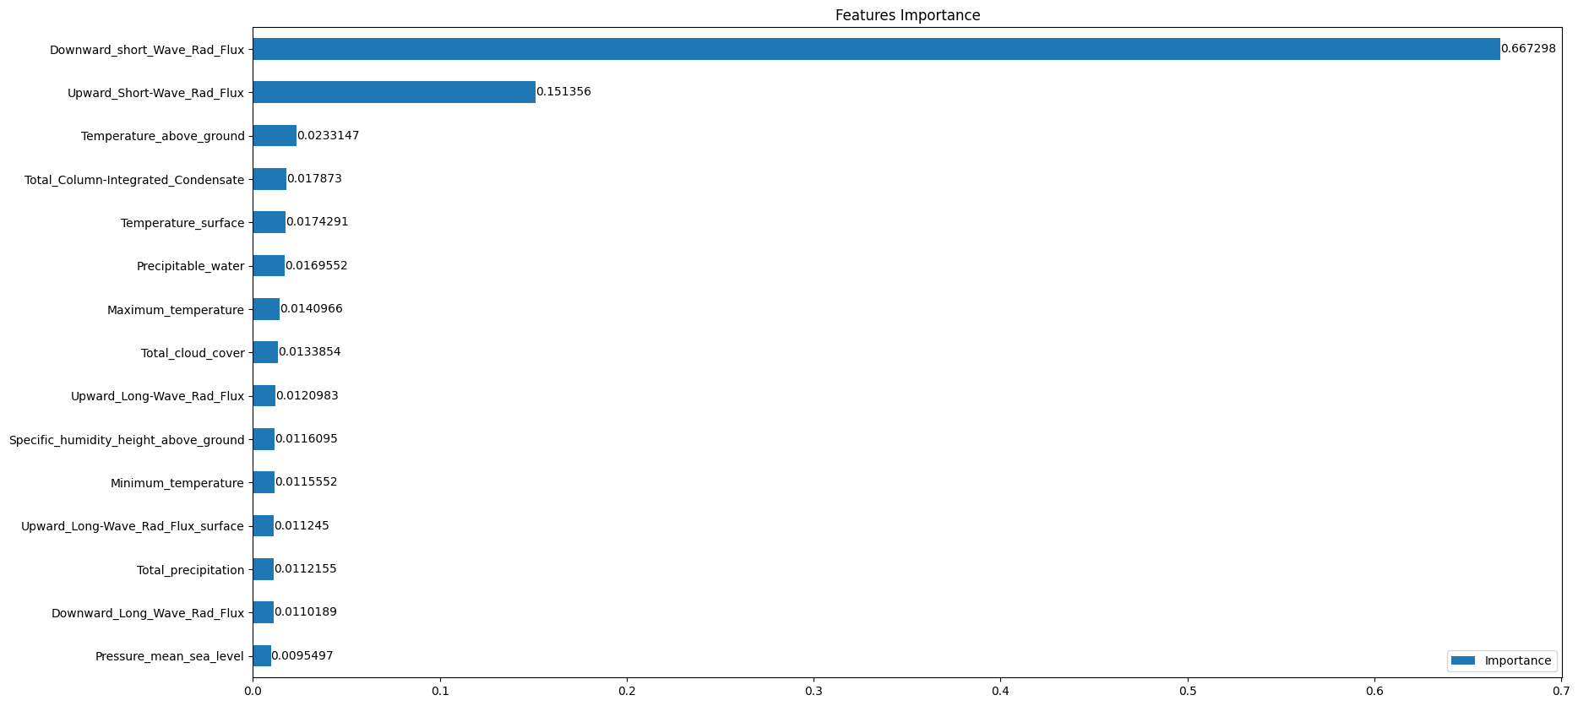
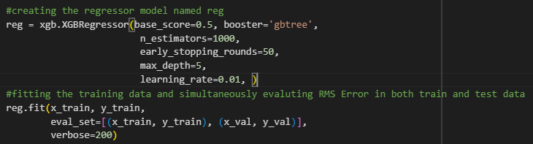
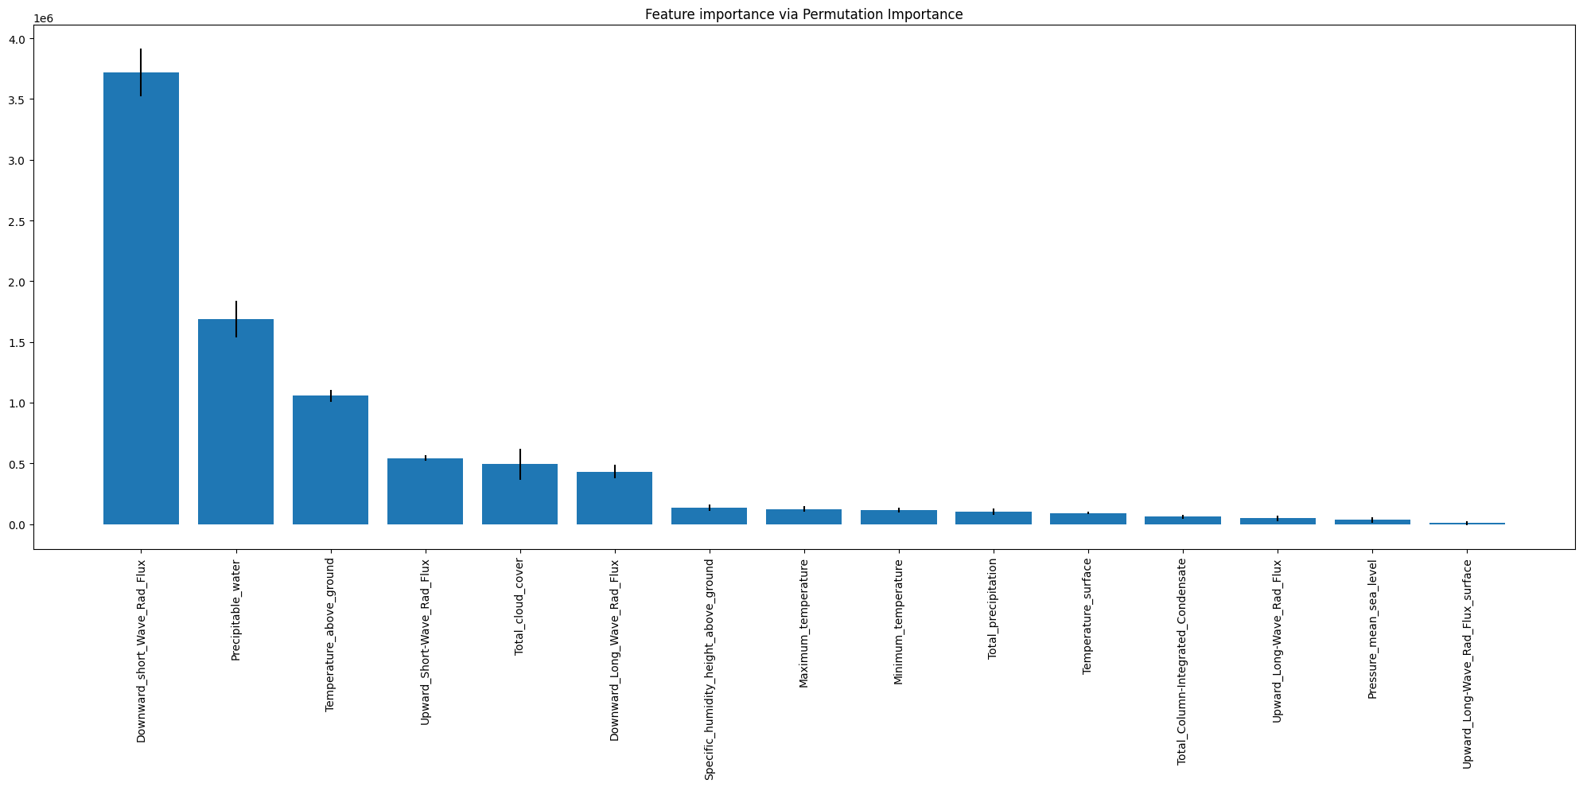
Results and interpretation
Scores from Preliminary Model -
R2: 0.7829
MEA: 2390521.44
RMSE: 3313316.32

Slide 6
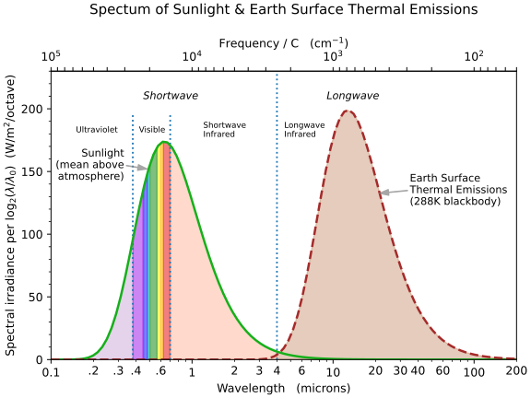
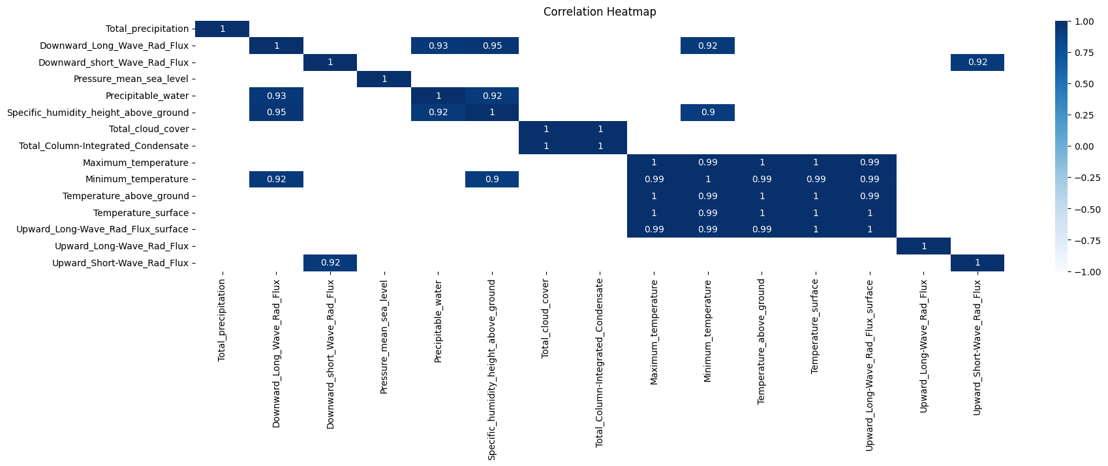
Results and interpretation cont.
Downward_short_Wave_Rad_Flux:
Signifies amount of incoming solar radiation to the earth’s surface. More value indicates more potential solar energy.
Precipitable_water:
Total amount of water vapor present in the atmosphere. It can absorb solar radiation.
Temperature_above_ground:
Also called Air Temperature. Air molecules with water vapor absorbs certain wavelengths. .
Upward_Short-Wave_Rad_Flux:
Amount of shortwave radiation reflected from the Earth's surface. Lower albedo (reflectivity) of the ground surface translates to less reflection and potentially more energy available on earth.
Heatmap shows very high positive correlation between some of the variables.

Slide 7
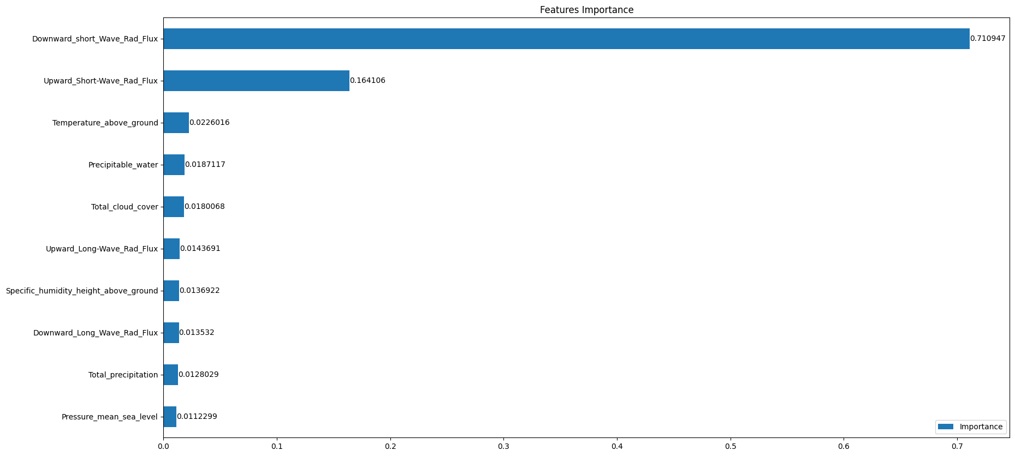
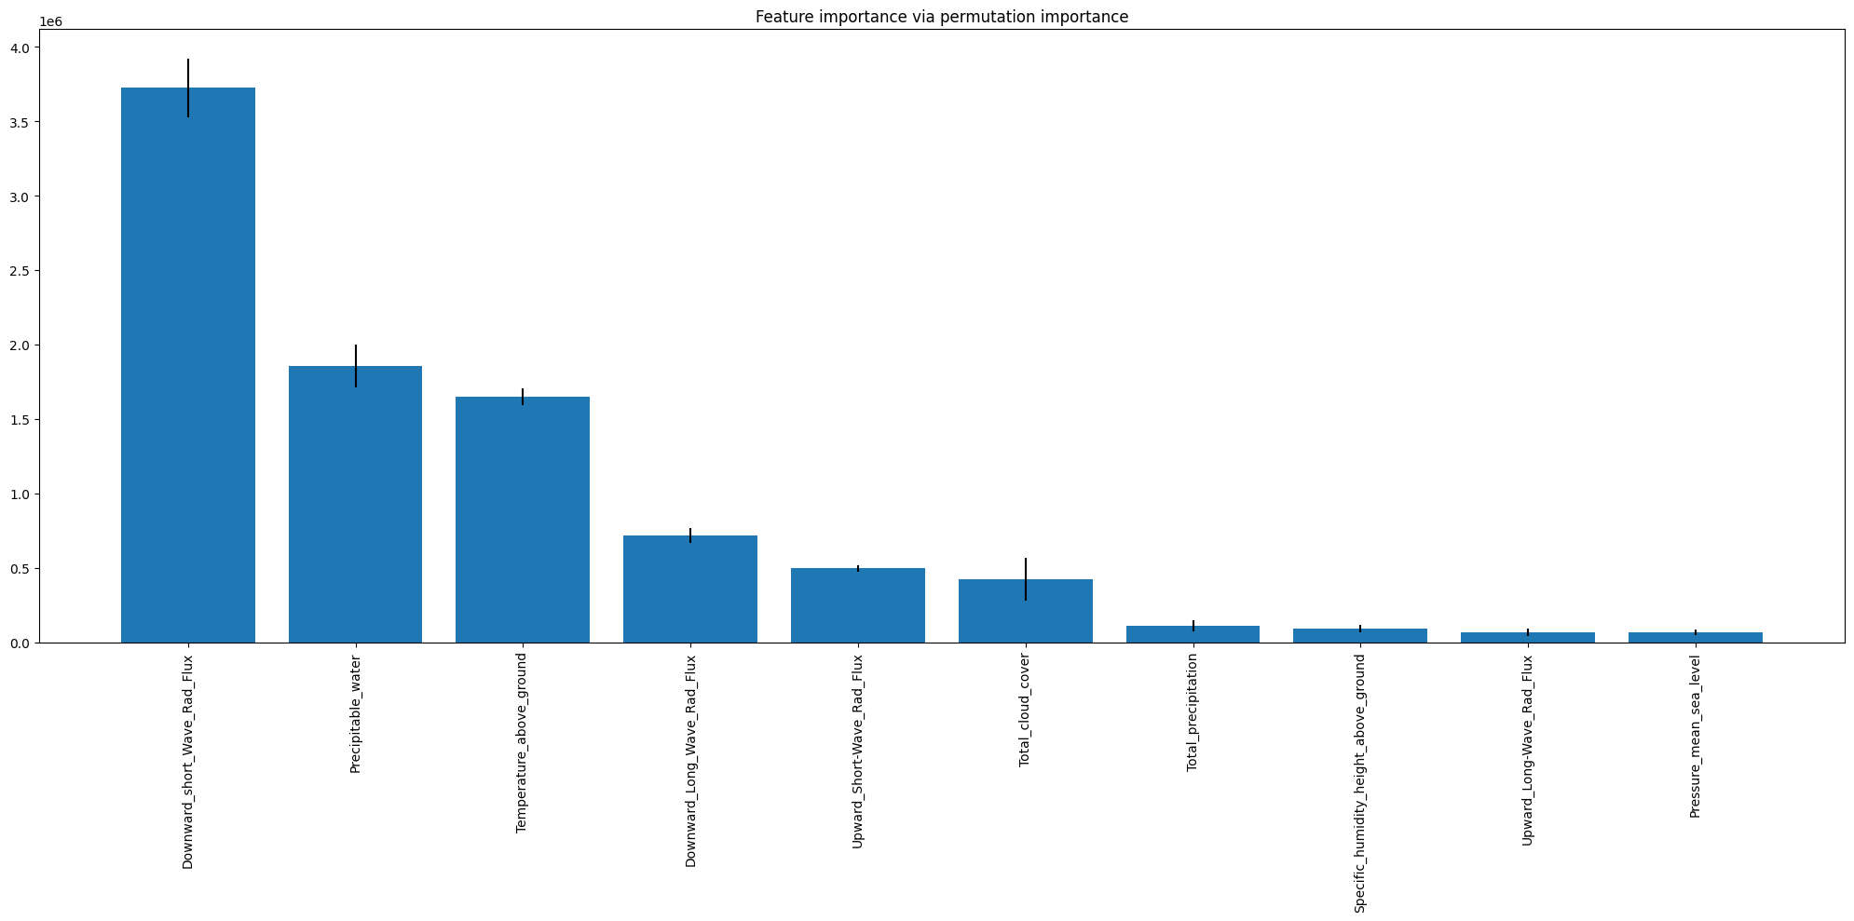
Results and interpretation cont.
Scores from Reduced Features Model-
R2: 0.7846 #Change in R2 Score 0.0017
MEA: 2392578.70 #Change in MAE 2057.264
RMSE: 3299903.57 #Change in RMSE -13412.740
Recursive Feature Elimination also backs up this feature selection and gives all of them important ranking and doesn’t eliminate any of them.

Slide 8
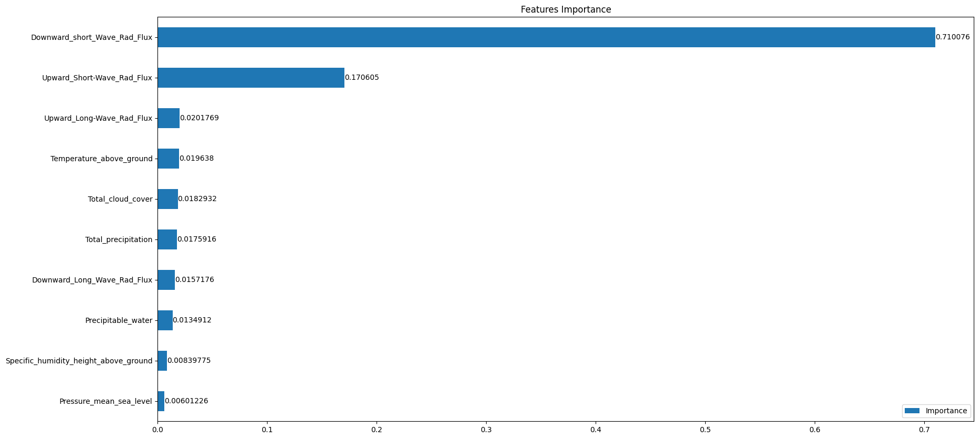
Results and interpretation cont.
Best Parameters from Grid Search:
'learning_rate': 0.01
'max_depth': 3
'n_estimators': 2000
Best Parameters from Hyperband Analysis:
'learning_rate': 0.1
'max_depth': 3
'n_estimators': 1900
'colsample_bytree': 0.630
'gamma': 4.07
Scores from Reduced Features Model after Hyperparameter tuning(Grid Search)-
R2: 0.7934 #Change in R2 Score 0.0087
MEA: 2373725.21 #Change in MAE -18853.49
RMSE: 3232521.37 #Change in RMSE -67382.20

Slide 9
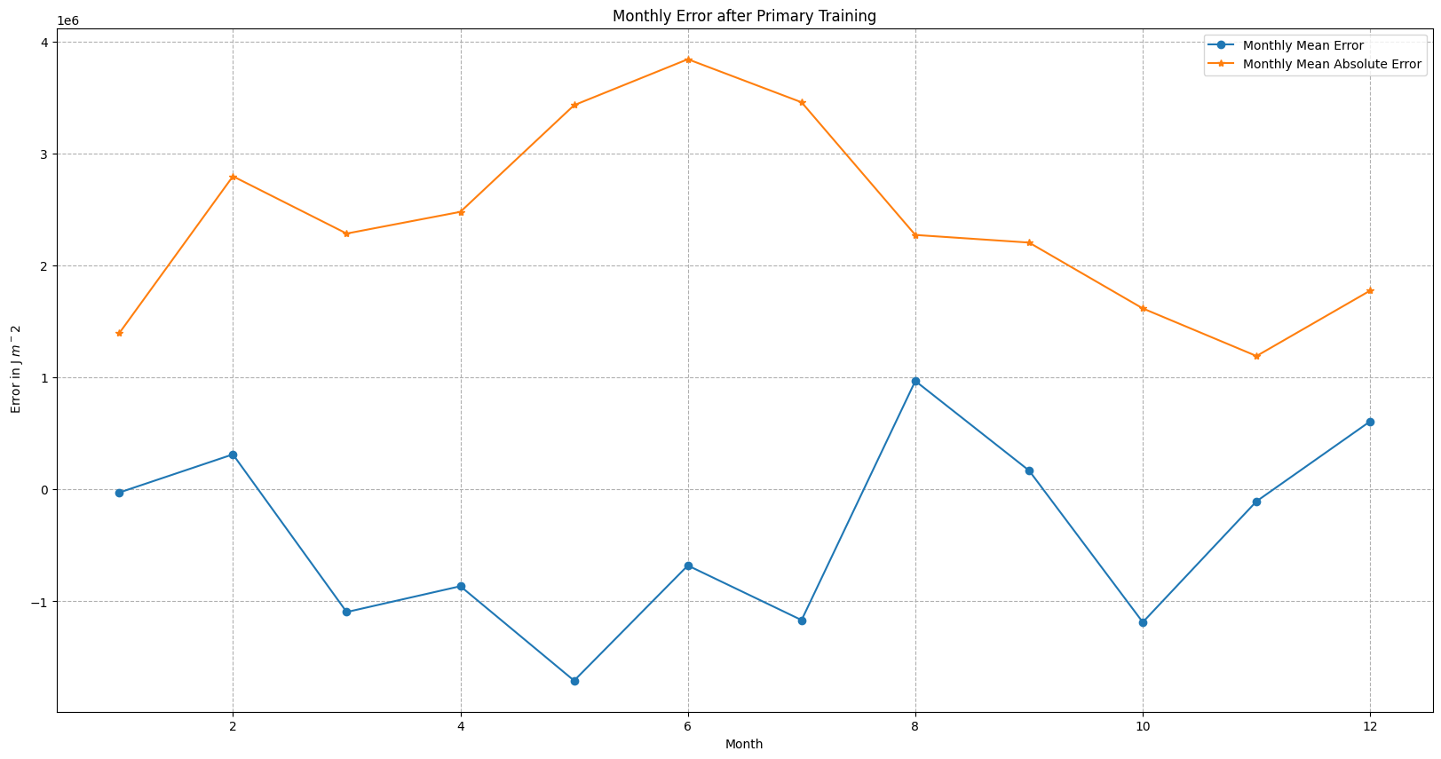
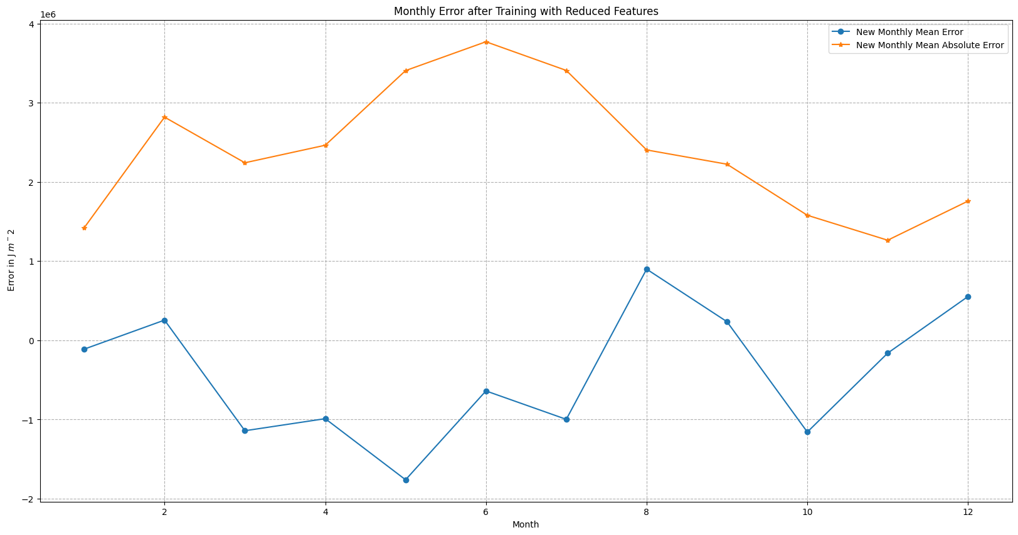
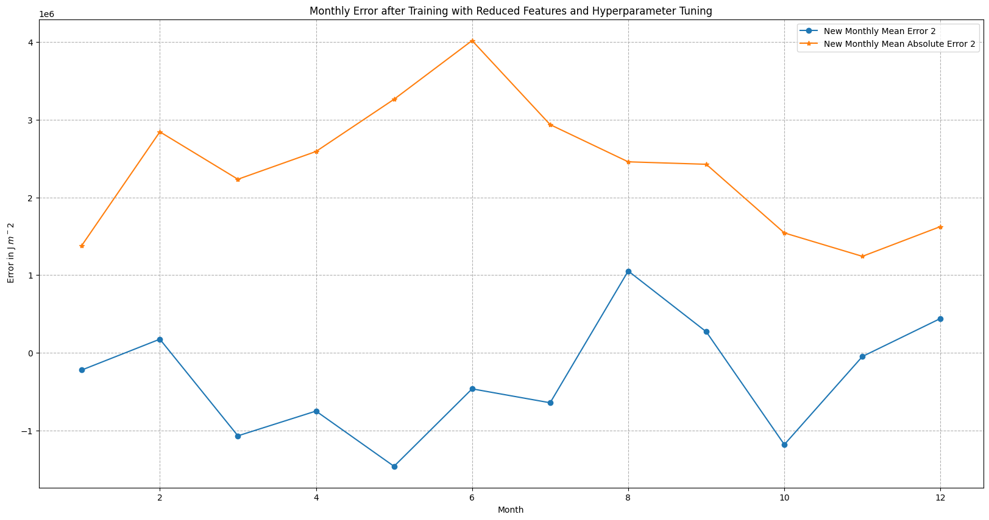
Results and interpretation cont.
Why higher errors in the months of April, May, June, and July?
Spring and summer months in Oklahoma typically experience more frequent cloud cover compared to fall and winter.
Increased convective activity, leading to afternoon thunderstorms and showers.(rapid weather changes)
Have higher humidity levels compared to drier fall and winter months. Complex interaction between humidity and solar radiation.
Steeper change in the solar zenith angle (angle between the sun and a location on Earth)

Slide 10
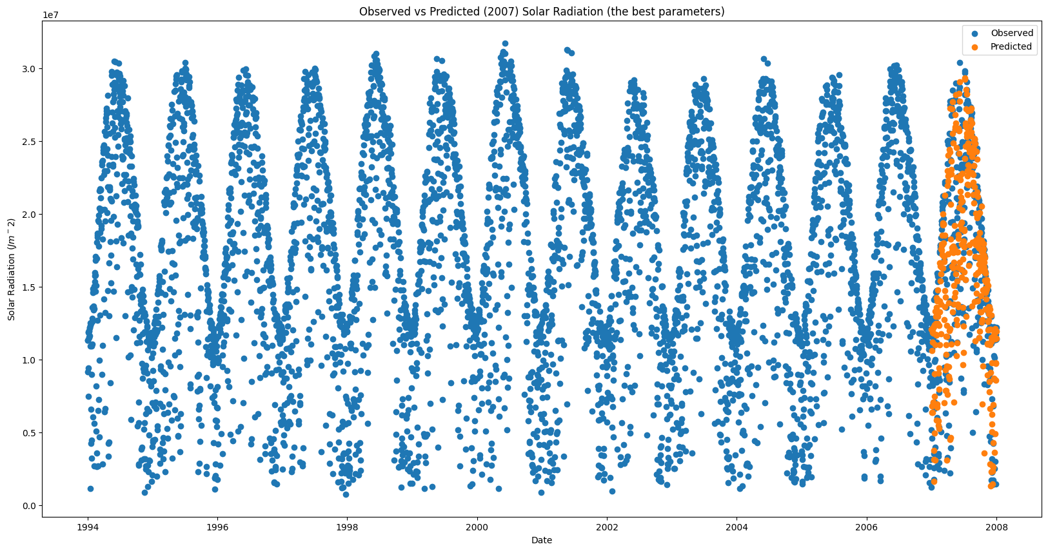
Prediction

Slide 11
learnings
Contributions
Necessity to predict the Solar Energy and usage of Machine Learning in that field.
Importance of data preprocessing; high complexity of climate data with different variables, spatial resolution and temporal frequencies.
Impact of correlated features and potential of features selection and engineering to enhance the model performance.
Use of xAI methods.
Combined Feature Importance Techniques (built-in XGBoost, permutation importance, recursive feature elimination) to identify the most impactful features.
Systematic approach to effective hyperparameter tuning (grid search, hyperband analysis).
Physical interpretations adds valuable context to the model and provides credibility to the predictions.
Extracted all the variables : Satyajeet
Compiled into a single DataFrame : Satyajeet
Non graphical data inspection : Shovan
Created correlation heat map : Shovan
Learnt about XGBoost : Both
Implemented it to train a model : Both
Permutation Analysis : Satyajeet
Recursive Feature Elimination : Shovan
Grid Search: Satyajeet
Hyperband: Shovan
Monthly Error Plots: Shovan
Scores and Prediction Plots: Satyajeet

Slide 12
Thank You...

